Slide 1
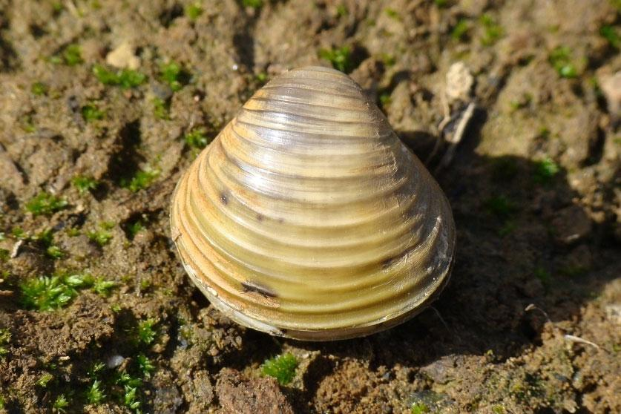
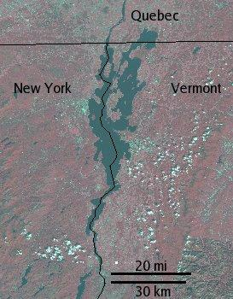
Risk Assessment of Asian Clam Arrival in Lake Champlain
Julie Coffey, Noah Lavallee, Hayley Perrone, Justin Karwatowski

Slide 2
Our Objectives
To assess the potential impacts of the impending arrival of Asian Clam in Lake Champlain and to examine possible control methods by investigating the following:
Water quality and nutrient loading
algal blooms
Other organisms: from phytoplankton to fish
Human use through recreation and economic activity
Establish a response framework and evaluate effectiveness of containment techniques
Notes:
Noah

Slide 3
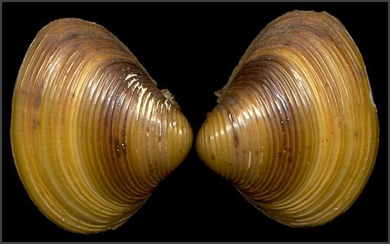
About the Clam
Living Conditions
Corbiucla fluminea are very tolerant of water conditions such as temperature and pH. They can survive in waters with a pH value as low as 5.6.
C. fluminea was believed to be intolerant of temperatures below 2 degrees C, but their presence in Lake George would seem to indicate otherwise.
The clam requires a substrate of silt sand or gravel to establish a significant population.
It appears that healthy populations require 6mg/L of Calcium at a pH of > 6.5 although no studies yet confirm this.
Notes:
Noah

Slide 4
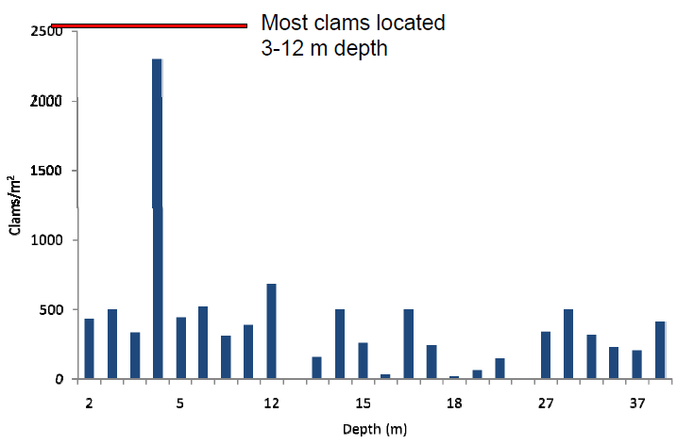
Depth Preference
Lake Tahoe Findings
Notes:
Noah

Slide 5
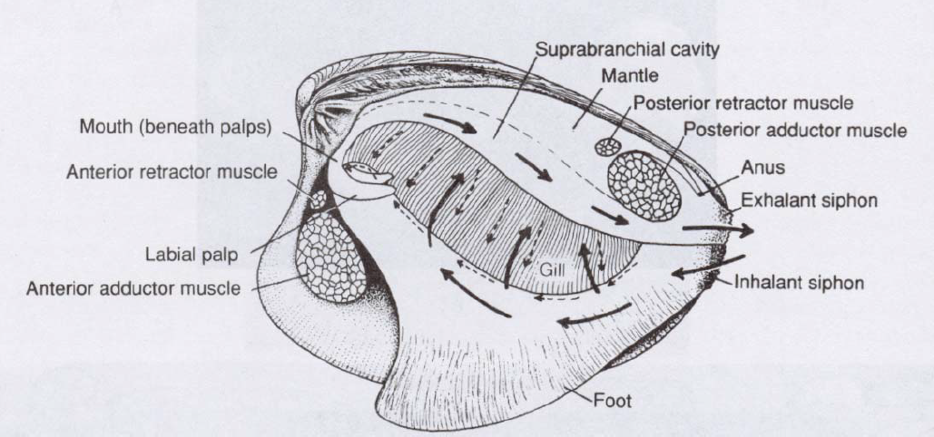
Reproduction
The clam becomes sexually mature at between three to eight months and has the ability to reproduce both sexually and asexually.
Asian clams reproduce at least two times a season. The average number of offspring per reproductive cycle is up for debate. Lake George Asian Clam Rapid Response Task Force indicates 2,000 to 4,000 larvae are produced per cycle while another reputable source indicates in the figure to be closer to 68,000 larvae.
These larvae are highly mobile, and with the aid of mucous threads they can remain suspended in the water column and disperse over long distances with the aid of natural currents.
Notes:
Noah

Slide 6
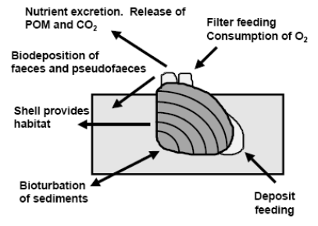
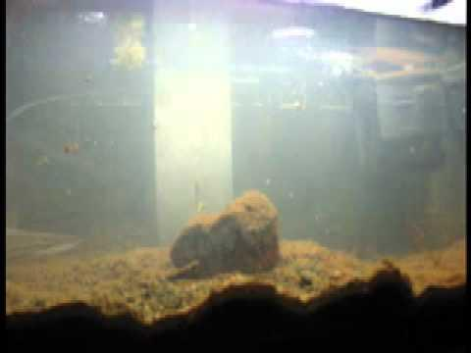
Feeding Habits
Feeds on Plankton by water filtration through siphons
A medium sized clam in ideal conditions can filter between 67.3 - 147.7 ml/hour
An small established population can have greater than 3000 individuals per m2.
This means that for every sq meter, between 201 and 441 Liters an hour are filtered for a small population.
Also has the ability to pedal feed
Notes:
Noah

Slide 7
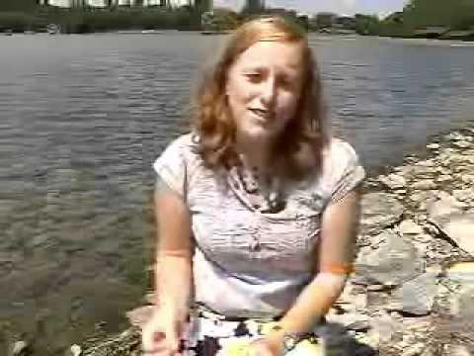
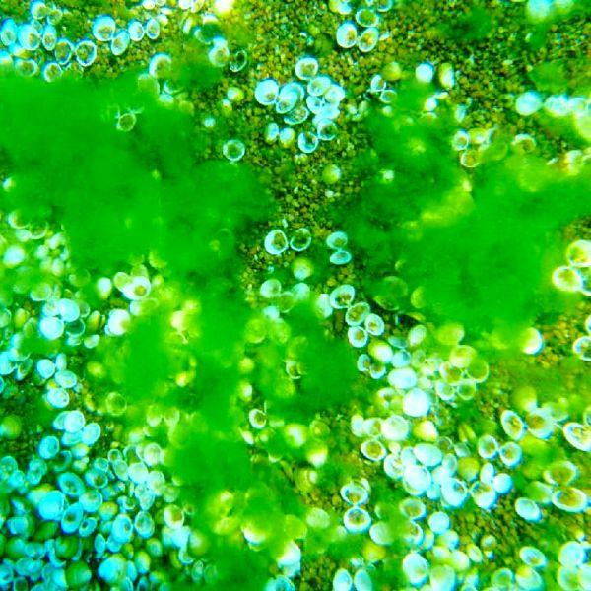
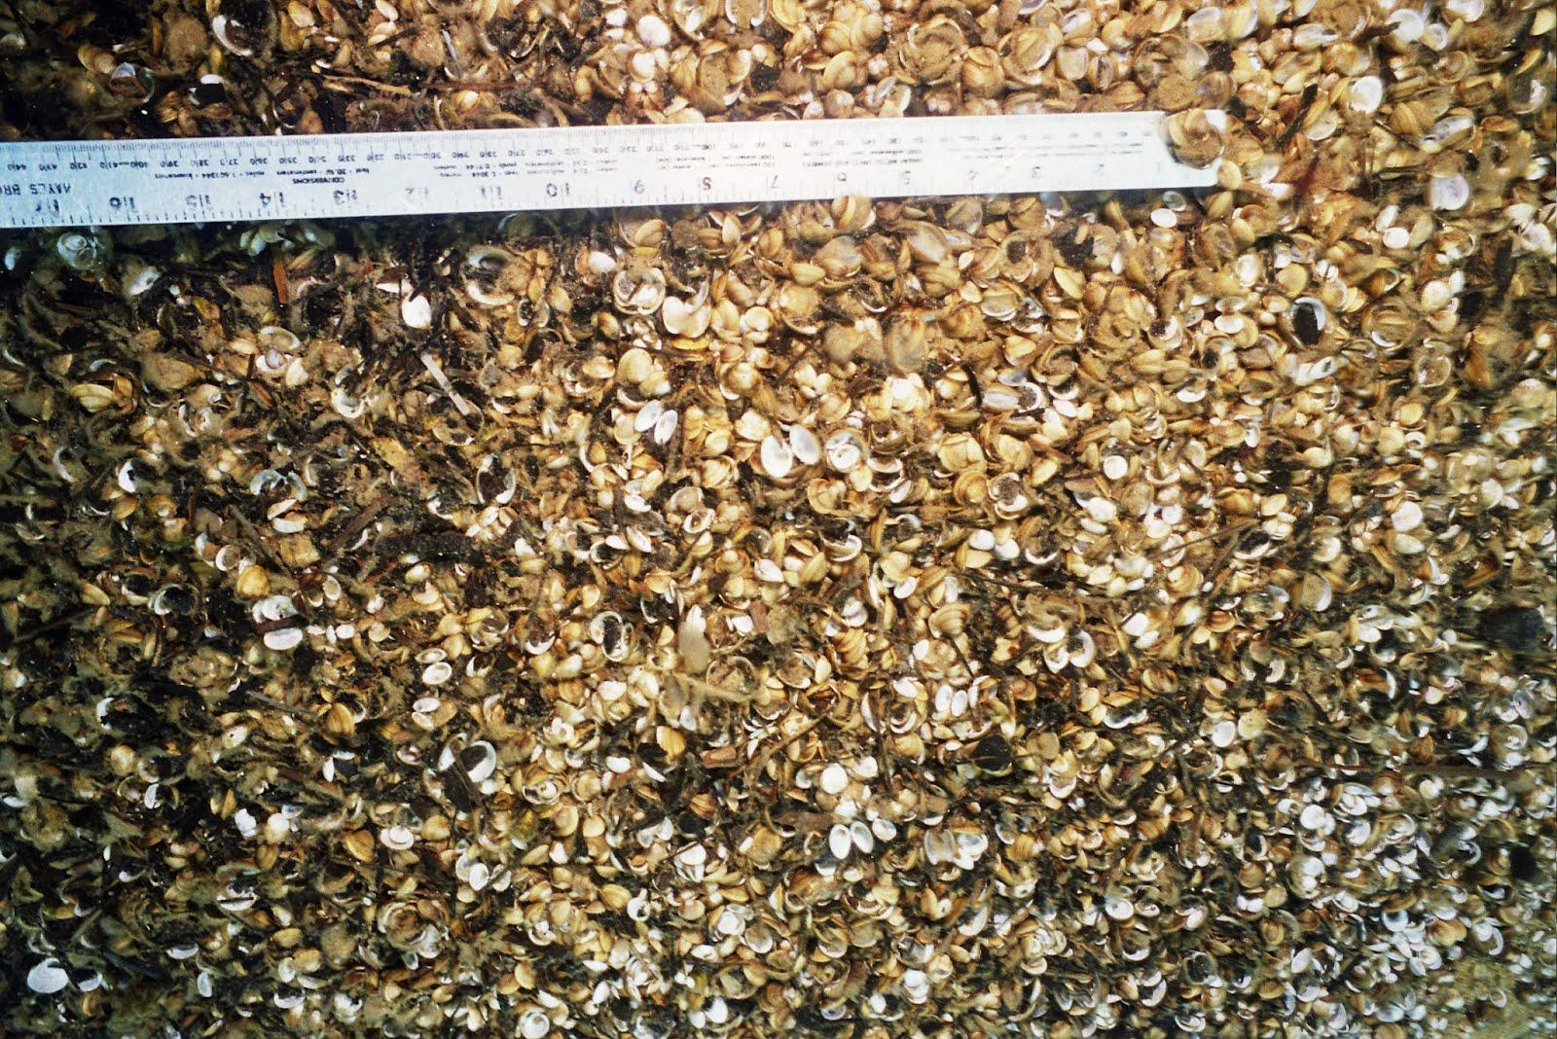
Why Do We Care?
Swimming
Boating
Aesthetics
Ecosystem services
Drinking Water
Fishing
Tourism
Toxic Algal Blooms
Biofouling
Notes:
Noah

Slide 8
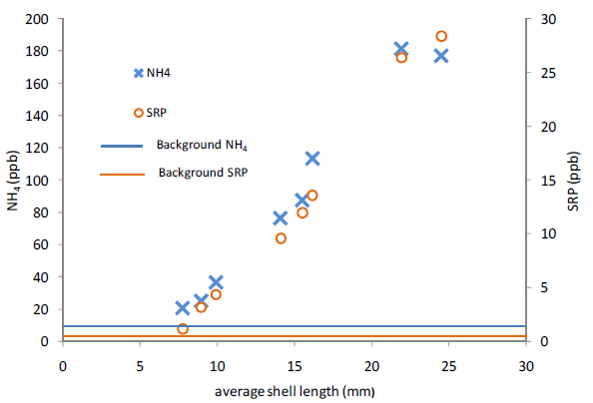
Nutrient excretion (ppb) by individual per day for Asian clam in Summer temperature conditions (19°C)
comparison to ambient background levels in Lake Tahoe
Notes:
Noah

Slide 9
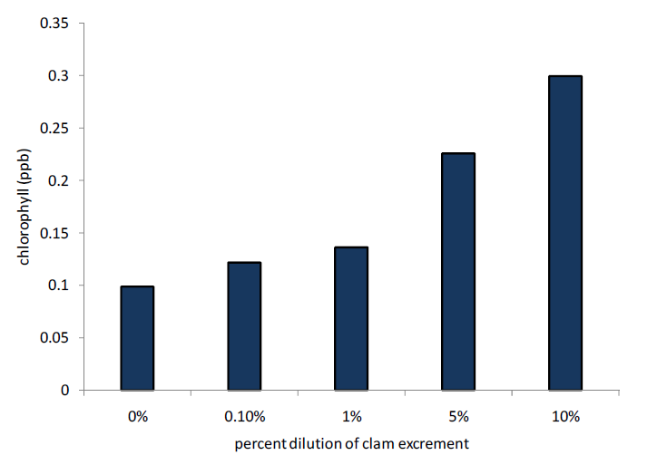
Effects of Clam Excretions on Phytoplankton
Notes:
Noah

Slide 10
Effects on Native Mussel Species
Asian clam die offs cause large concentrations of ammonia to be released into overlying waters.
Heavy densities of Asian clams (~10,000 clams/m²) can cause concentrations of up to 5.04 mg/L at 26 + 2°C. (Cherry et al., 2005)
These concentrations of ammonia are lethal to freshwater mussels and other organisms that currently inhabit Lake Champlain.
The fluted shell, pocketbook mussel, eastern floater, giant floater, and the eastern lampmussel are examples of freshwater mussels that exist in Lake Champlain and are highly sensitive to changes in ammonia concentration. (Davis, 2008)

Slide 11
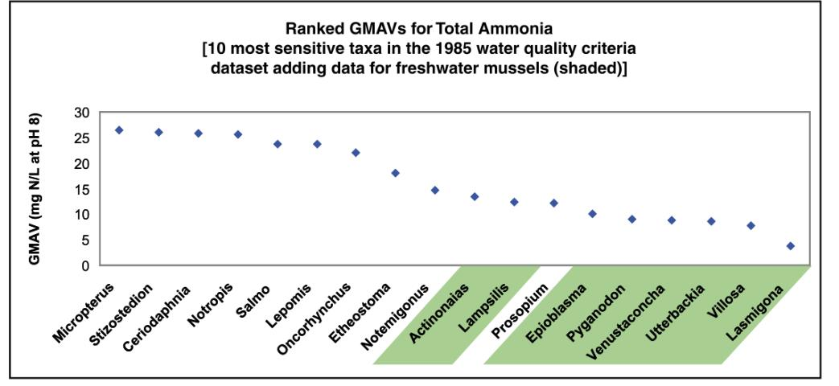
(Davis, 2008)
* Red circle indicates taxa that exists in the Lake Champlain Basin
Notes:
GMAV=if data from several species in a single genus are available, the Species Mean Acute Values are pooled to calculate a geometric mean of the genus toxic concentration. this is a list of mussels that are sensitive to fluxes in the concentration of ammonia in the water.

Slide 12
Effects on Native Mussel Species
Native mussel species and Asian clams are both filter feeders and must compete for resources.
Asian Clam filtration rates have been measured at about 11-1370 ml/hr/clam (Lauritsen, 1986), whereas Unionidae can only filter around 60-490 ml/hr/clam. (Mattice et al., 1973).
This difference in filtering activity gives the Asian clam an advantage over native mussel species for resources.

Slide 13
Effects on Native Fish Species (DO)
In heavy densities of Asian clam, dissolved oxygen in the water can drop down to about 1.0 mg/L. (Cherry et al., 2005)
Such low levels of dissolved oxygen are deadly for native fish species.
Low levels of dissolved oxygen in the water causes native fish populations to become stressed. In this state, they will not eat or reproduce. If this state continues, the fish will die.

Slide 14
Effects on native fish species (NH₄)
Chronic exposure to ammonia in the water can cause the fish population to become stressed and cause damage to gills and other tissues.
The damaged tissue caused by ammonia levels in the water leave the fish susceptible to bacterial infections and can stunt the growth of juvenile fish. (Floyd et al., 2005)
High levels of ammonia are lethal to fish populations and will lead to large amounts of fish kill.

Slide 15
Effects on Native Fish Species (Competition)
Asian clams are voracious filter feeders, but have also been known to pedal feed in times of food scarcity.
Asian clams effectively filter phytoplankton and bacteria (mainly rotifers) out of the water column. (Allen et al., 2008)
The high rates at which the Asian clam filters the phytoplankton leads to a sharp decrease in the amount of zooplankton that exists in the ecosystem. The decrease in zooplankton causes a decrease in the amount of small feeder fish, which then leads to a decrease in the large fish populations.
Fish populations in Lake Champlain will be forced to compete with the Asian clam population for oxygen and for food resources.

Slide 16
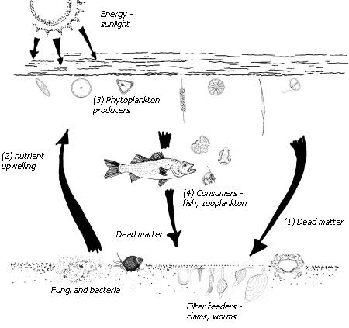
CLAMS!

Slide 17
Effects on Lake Champlain Fishery
Species of fish that exist in Lake Champlain that are prized by anglers include (but are not limited to) large and smallmouth bass, walleye, northern pike, chain pickerel, brown bullhead, channel catfish, yellow perch, lake trout, landlocked Atlantic salmon, steelhead trout, brown trout, and rainbow smelt. (lcbp.org)
The Lake Champlain fishery is based on angling (the only source of commercial sales) of walleye, yellow perch, basses, smelt, and pikes (Young, 2009). An estimate from 1991 found that between 200,000 to 750,000 lbs of fish were sold (Young, 2009)

Slide 18
Effects on Lake Champlain Fishery
Anglers fishing Lake Champlain spent $205 million in a year. (mychamplain.net)
Hunting, fishing and wildlife watching made up 5 percent of Vermont's gross state product (GSP). This is 4th in the Nation as a percentage of GSP after Alaska, Montana and Wyoming, respectively. (mychamplain.net)
If Anglers are forced to look elsewhere for their desired catches, lakeside communities, businesses and the department of fish and wildlife can expect to see sharp declines in revenue from tourism.

Slide 19
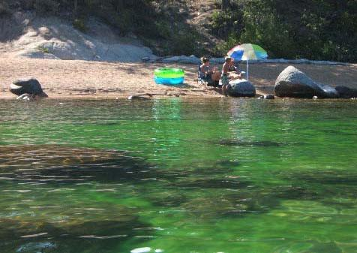
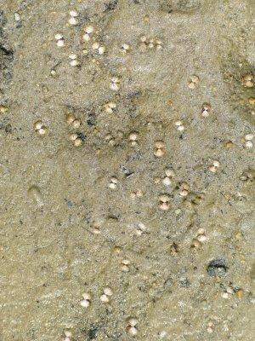
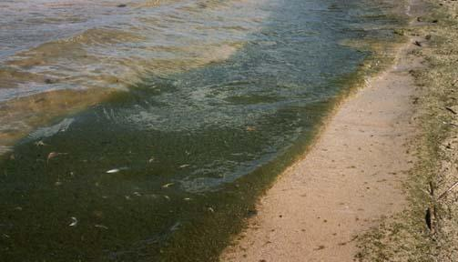
Other Recreational Impacts
Declined asthetics
increase in poisonous algae blooms
sharp shell accumulations on beaches (bring water shoes)
biofouling of water intakes for boats.
Decreased tourism revenue across the board

Slide 20
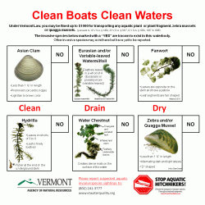
Vectors for Transport
Clams can travel via:
Larval dispersal
Bait buckets
Boats and equipment
Imported sand and sediment
Aquaria
Ballast water
Notes:
Julie

Slide 21
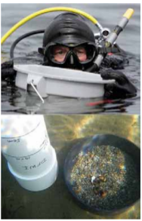
Recommendations: Prior to Infestation
EDUCATION
Conduct lake-wide surveys
Provide educational literature
Poster public recreational areas
COMMUNICATION
Keep in touch with surrounding states and LGACRRTF for updates on clam movement
Notes:
Julie

Slide 22
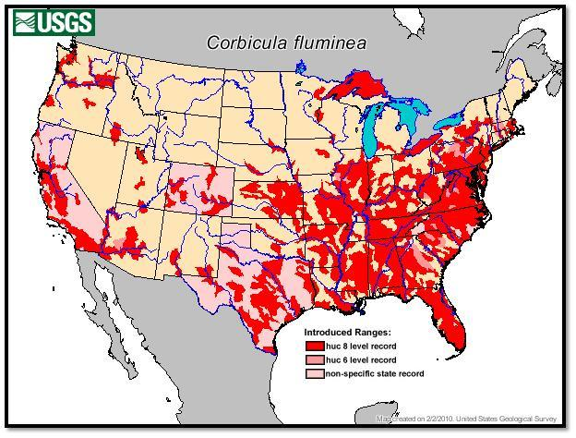
Notes:
Julie

Slide 23
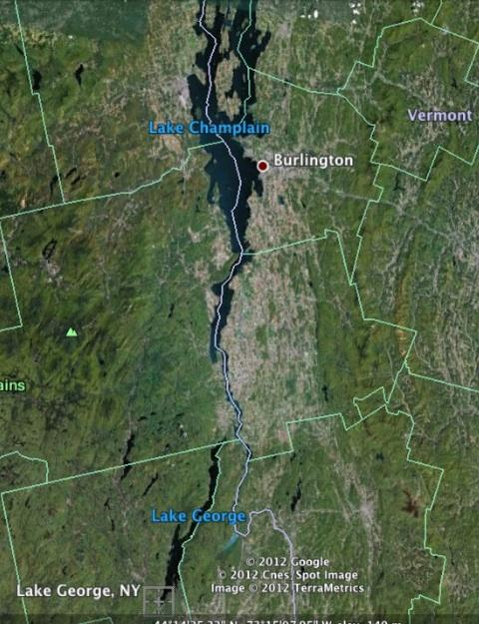
The Lake George Lake Champlain Connection
Lake Champlain and Lake George are separated by only 10 miles of water.
Unfortunately the clam has already reached Lake George (outlined in red).
Preventing the clam's invasion of Lake Champlain will rely heavily on the control
efforts in Lake Georg and the education of the public on the risk of spreading the clam to Champlain.
Notes:
Julie

Slide 24
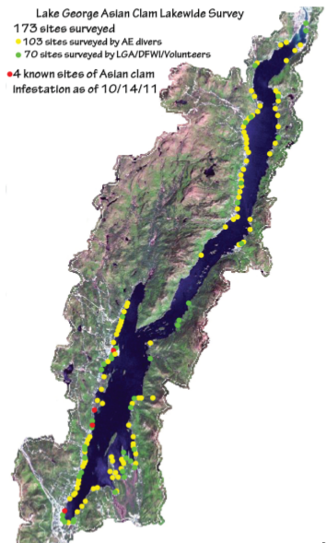
To Lake Champlain
So....where is the clam now?
Treasure
Cove
Norowal Marina
Boon Bay
Site of benthic mats treatment
(discussed later in presentation)
Lake George VIllage
Notes:
Julie

Slide 25
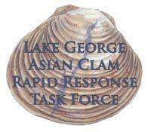
Introduction to L. George Infestation
The clams were first found in the Lake Champlain Basin in August 2010. The Lake George Asian Clam Rapid Response Task Force (LGACRRTF) was formed to tackle the problem
Lake George Village was the first infestation site, with the clam now present in over 15 acres
Notes:
Julie

Slide 26
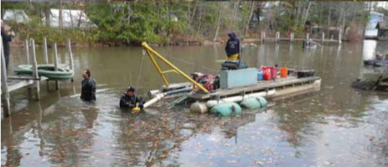
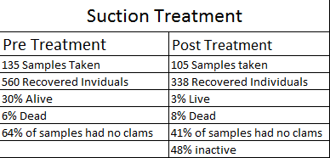
Lake George Treatments
Treasure Cove: Suction Harvesting
In late October 2011 the task force experimented with suction harvesting in Treasure Cove due to its rocky bottom that made it unsuitable for benthic matting
Removed 52 cubic yards of sediment were removed within 1 acre.
Results were not encouraging
Notes:
Julie

Slide 27
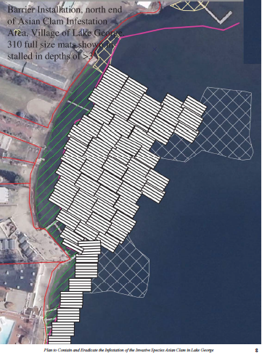
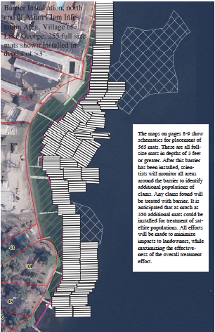
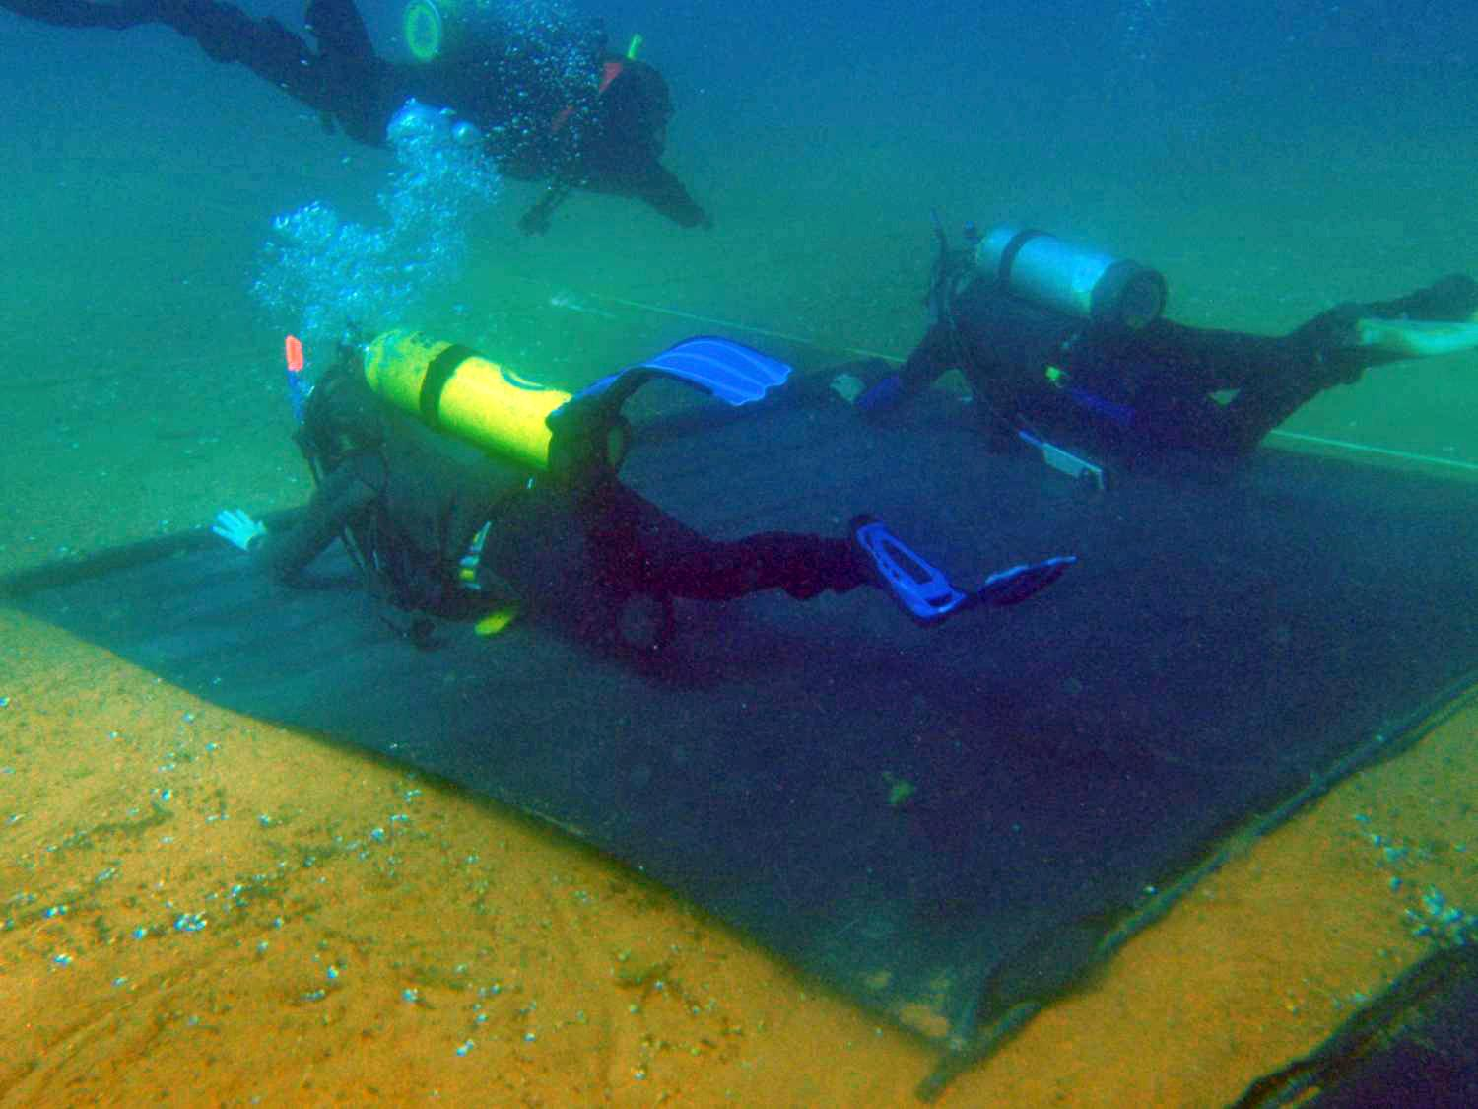
Lake George Benthic Mat Treatments
Lake George Village:
Treated 5.5 acres with benthic mats
99% mortality!
Norowal Marina:
Treated 2 acres with benthic mats
Clams under docks survived...
Notes:
Julie

Slide 28
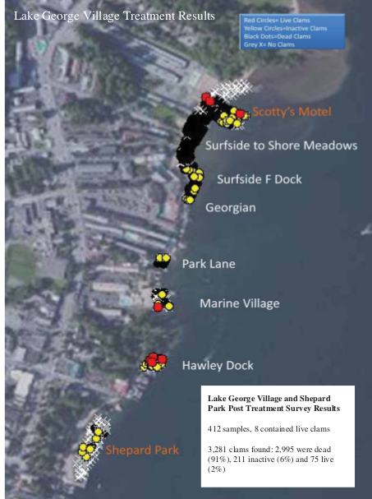
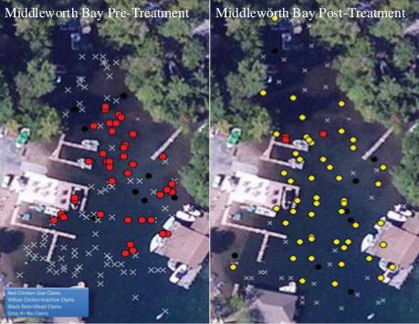
Treatment Results:
Red- Live Clams
Yellow- Inactive Clams
Black- Dead Clams
Notes:
Julie

Slide 29
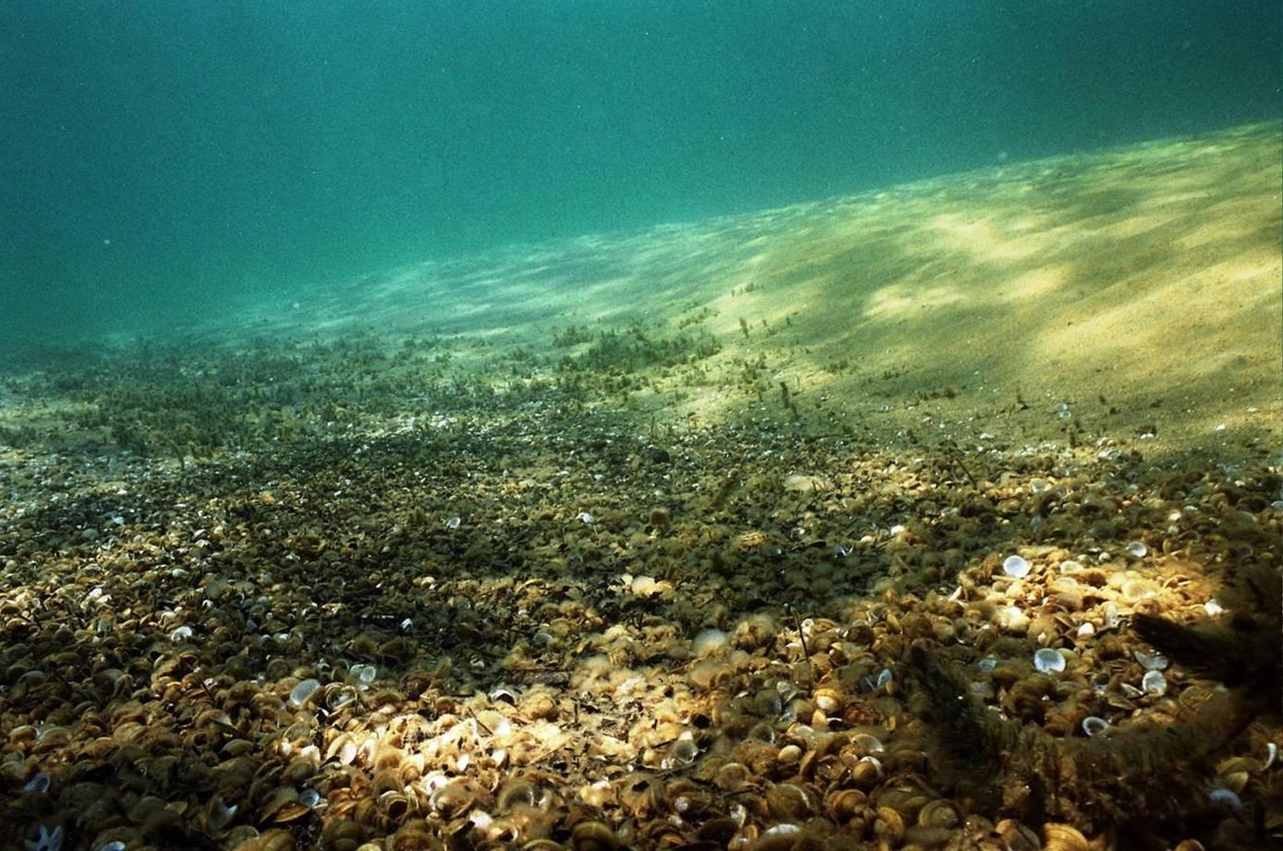
Recommendations: Post-Infestation
Conduct Lake-wide survey of extent of colonization
Establish an eradication plan and timeline
Treat infested areas
Monitor success and adapt future plans accordingly
Notes:
Justin

Slide 30
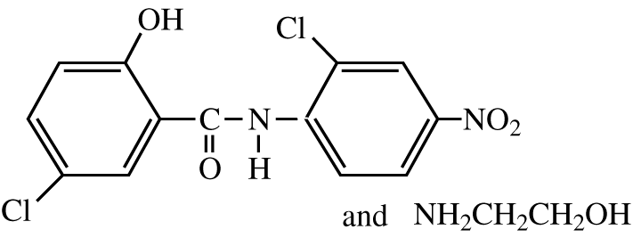
Treatment Method 1: Chemical Treatment
A chemical called Bayluscide was examined as a treatment method for the eradication of Corbicula Fluminea
Bayluscide (Active Ingredient is Niclosamide) is a piscicide used to combat invasive aquatic species
Laboratory tests found the chemical to be ineffective and this method of treatment was thus eliminated.
Chemical Formula for Niclosamide
Notes:
Justin

Slide 31
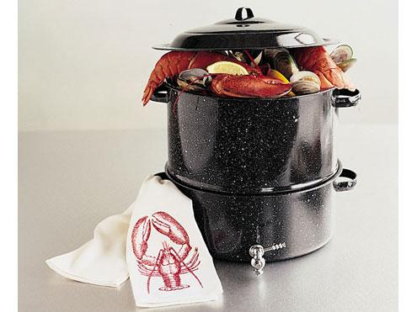
Treatment Method 2: Heat Treatment
Heat treatment involves pumping hot water on to the clams on and directly under the surface
Heat tests were run on December 6th, 2010 in Lake George to determine the efficiency of this treatment method
The results were not satisfactory, so this was ruled out as a viable option.
Notes:
Justin

Slide 32
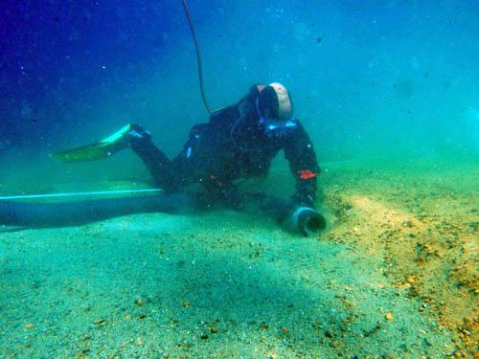
Treatment Method 3: Suction Harvesting
Suction Harvesting involves sending divers to the lake bottom to remove the top layer of sediment through a vacuum system
This option had moderate success in Lake George, especially in rocky areas where benthic mats can't form a tight seal.
High operation costs, and ice-out conditions make this method less favorable

Slide 33
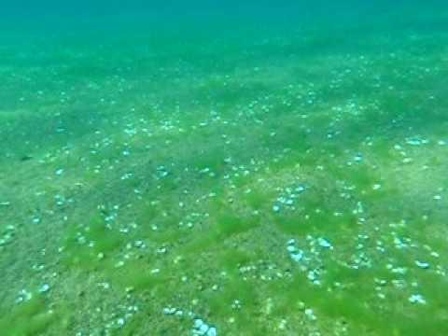
Treatment Method 4: No Treatment Option
The No Treatment option has had mixed results.
In the Potomac River Estuary near Washington, DC. phytoplankton concentrations were reduced by 40-60% in areas of high Asian Clam density.
Water clarity was reported to have tripled, and submerged vegetation that had been absent for ~50 years returned.
The clam population decreased by 25% from 1984-1986, and a further 25% from 1986-1992.
Interestingly, algal blooms which were absent during the early 80's reappeared in 1993, when the clam population was in decline.

Slide 34
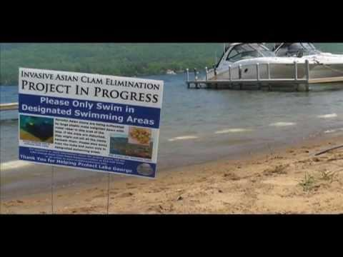
Treatment Method 5: Benthic Mats
(Prefered Method)
Benthic mats are 20 mm thick PVC barriers that are laid over affected areas.
The mats overlap to form an airtight seal and smother whatever is underneath. The mats are generally left in place for 4-6 weeks, but they can be left for longer.
Benthic mats have been used successfully in Lake George to treat Eurasian Water Milfoil.
This is widely considered the most effective treatment method.

Slide 35
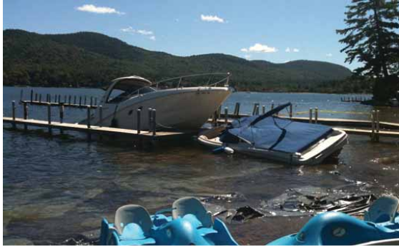
Downsides to Benthic Mats
Storm Damage
Can't use in all locations due to boulders and lake bottom topography
Mats kill whatever is trapped underneath them.
When large amounts of clams are killed at once (via mats) they release a fairly significant amount of ammonia into the water.

Slide 36
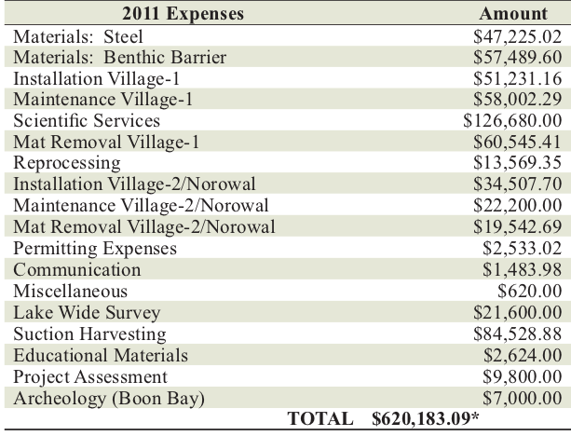
Estimated Costs- Containment
*Note* These numbers are from Lake George

Slide 37
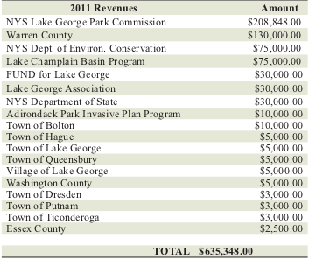
Allocated Revenue for Invasives
Notice:
This is more than was spent for control
measures in 2011!!!!!

Slide 38

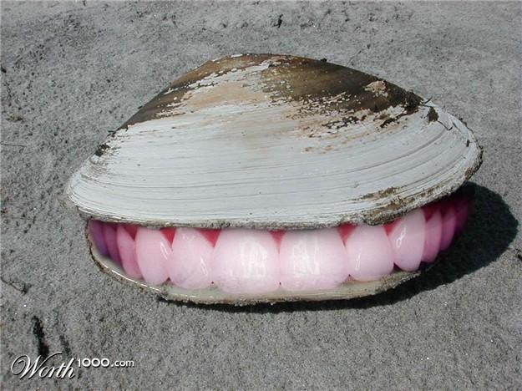
Conclusion
If we use what was learned from Lake George and Lake Tahoe we are in a good position.
Prevention is key, and the best way to do this is by spreading awareness and educating the public.
Containment: Act quickly. Asian clams are extremely proficient when it comes to reproduction. You need to monitor the lake and act quickly in the event of invasion.
Eradication: Better safe than sorry. Benthic mats are currently the best option for total eradication of the invasive clams as they are the most efficient.
If we don't learn from past mistakes we could end up....
Did Learn
Didn't Learn

Slide 39
Works Cited
Bidwell, Joseph R.; Cherry, Donald S.; Cooper, Naomi L.; Scheller, Jennifer L. 2005. Potential effects of Asian clam (Corbicula fluminea) die-offs on native freshwater mussels (Unionidae) I: water-column ammonia levels and ammonia toxicity. Journal of the North American Benthological Society. 369-380.
Davis, Wayne S.; Grabarkiewicz, Jeffrey D. 2008. An Introduction to Freshwater Mussels as a Biological Indicator. http://www.epa.gov/bioindicators/html/publications.html. 25-30.
Lauritsen, D.D. 1986. Filter Feeding in Corbicula fluminea and its Effect on Seston Removal. Journal of the North American Benthological Society. 5(3):165-172.
Stanczyowska, A.; Lawacz, W. and Mattice, J. 1973. Bivalves as a Factor Affecting Circulation of Matter in the Lake. International Symposium on Eutrophication and Water Quality Control. 53-58.
Young, B. A., Bouffard, W.R., & Chipman, B.D. (2000). Strategic Plan for Lake Champlain Fisheries. Fisheries Technical Committee of the Lake Champlain Fish and Wildlife Management Cooperative, Retrieved from http://www.vtfishandwildlife.com/library/Reports_and_Documents/Fisheries/Strategic_Plan_for_Lake_Champlain_Fisheries.pdf.
http://terc.ucdavis.edu/research/AsianClam2009.pdf
http://edis.ifas.ufl.edu/fa031
http://www.lcbp.org/fwsum.htm#fish
http://www.mychamplain.net/sites/default/files/Fishing%20Economic%20Fast%20Facts.pdf

Slide 40
Works cited continued
CM Way, Daniel J. Hornbach, CA Millerway, BS Payne, and A Miller. "Dynamics of Filter Feeding in Corbicula-fluminea (Bivalvia, Corbiculidae)"Canadian Journal of Zoology-Revue Canadienne de Zoologie 68.1 (1990): 115-120.
Francis-Floyd, Ruth, Craig Watson, Denise Petty, and Deborah B. Pouder. "Ammonia in Aquatic Systems." University of Florida IFAS Extension (2005): N. pag. Web.
Guhathakurta, Himadri, Raka Biswas, Prabuddha Dey, Piyali G. Mahapatra, and Bipasha Mondal. "Effect of Organic Forms of Phosphorus and Variable Concentrations of Sulfide on the Metabolic Generation of Soluble-reactive Phosphate by Sulfur Chemolithoautotrophs: a Laboratory Study." The International Society for Microbial Ecology Journal (2007): 545-550. Print.
"Lake Champlain Basin Program: Phosphorus Pollution." Lake Champlain Basin Program: Home. N.p., 27 Feb. 2011. Web. 25 Feb. 2012. <http://www.lcbp.org/phospsum.htm>.
"Lake Champlain Long-term Monitoring Program." Vermont Watershed Management Division Homepage. Lake Champlain Basin Program, n.d. Web. 25 Feb. 2012. <http://www.vtwaterquality.org/lakes/htm/lp_longterm.htm>.
"Lake George Asian Clam Eradication Project." Lake George Asian Clam Eradication Project. Lake George Asian Clam Rapid Response Task Force, n.d. Web. 24 Feb. 2012. <http://www.stoptheasianclam.info/>.
Menninger, Holly. "The Asian Clam, Corbicula Fluminea: A Brief Review of the Scientific Literature." Vital Signs. NY Invasive Species Research Institute. Web. 24 Feb. 2012. <http://vitalsignsme.org/>.
Pinckney, James L., Hans W. Paerl, Patricia Tester, and Tammi L. Richardson. "The Role of Nutrient Loading and Eutrophication in Estuarine Ecology." Environmental Health Perspectives VOLUME 109.SUPPLEMENT 5 | (2001): 699-706. Print.
Kappes, Heike, and Peter Haase. "Slow, But Steady: Dispersal of Freshwater Molluscs."Aquatic Sciences 74 (2011): 1-14. 02 Mar. 2011. Web. 24 Feb. 2012.
Wittmann, M., Reuter, J., Schladow, G., Hackley, S., Allen, B., Chandra, S., et al. (2008). “Asian clam (Corbicula fluminea) of Lake Tahoe: Preliminary scientific findings in support of a management.” http://169.237.166.248/research/AsianClam2009.pdf.
Zhang, L., Shen, Q., Hu, H., Shao, S., & Fan, C. (2011). “Impacts of corbicula fluminea on oxygen uptake and nutrient fluxes across the sediment–water interface.” Water Air Soil Pollut, (220), 399-411.

Slide 41
Video Cited
Lake George Asian Clam Start ~35 seconds in
http://www.youtube.com/watch?v=AID8o5rf7sY&feature=related
Asian Clam Filtering 1.12 seconds long
http://www.youtube.com/watch?v=fvyVfFU0DjI&feature=related
Asian Clam News Report
http://www.youtube.com/watch?v=6ilAGyA_4HE
Asian Clam shell litter
http://www.youtube.com/watch?v=KKxX9-MM2xs
http://www.youtube.com/watch?v=-k9Kz5GdDM8&feature=related

Slide 42
Photo Cited
Clam Steamer = http://iweb.cooking.com/images/products/enlarge/177925e.jpg
Bayluscide Formula = http://www.farmchemicalsinternational.com/images/structures/largeview/niclosamide.gif
Suction Harvesting = http://2.bp.blogspot.com/-fYGU-nsyyMk/TsQrVsC6DBI/AAAAAAAAAXw/4qrrYm5wD9c/s1600/suction+harvest+for+web.jpg
Stop Invasives=
http://www.vtwaterquality.org/lakes/htm/ans/lp_ans-index.htm
Food Web=
http://www.glf.dfo-mpo.gc.ca/Gulf/By-The-Sea-Guide/Introductory-Module
Algae Beach Photos
http://www.lakegeorge.com/lakefriendlyliving/2011/10/warren-countys-new-law-is-very-lake-friendly.html

